Slide 1
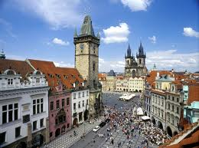
From Comenius to Cutting-Edge Curriculum
Is our thinking radical enough for today’s
international middle-level students?

Slide 2
Speech Explanation
This speech was given to the conference of the European League of Middle School Educators held in Prague on January 27th 2012 . Some 300 people attended the conference from Middle Schools ranging from Portugal to Moscow and from the northern Baltic to North Africa. While the majority of the participants were from essentially ‘Anglo-American’ type schools, the conference theme was based on the thinking of Jan Amos Comenius, the Czech philosopher of the 17th Century who had so influenced John Milton.
This was against a background of the profound question that I believe should be asked in the light of the recent death of Vaclav Havel the Czech writer and philosopher whose thinking had led to the overthrow of Communism and his appointment as first President of the Republic... a man who inspires extraordinary admiration from his people, and I wanted the conference to ponder what should be the proper relationship in that and other similar middle-European countries to the generality of international school curricula.

Slide 3
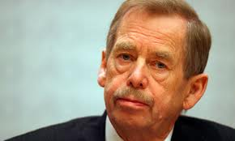
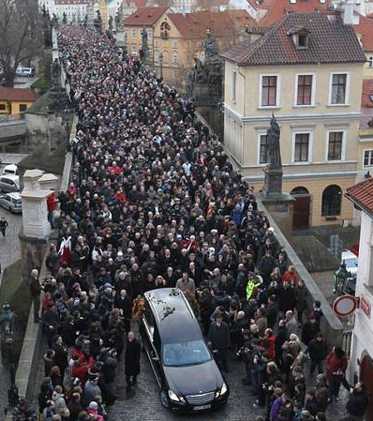
Václav Havel poet, philosopher*, playwright, political activist and prisoner and eventually President of his country
5 October 1936 – 18 December 2011
* See slide 40 of this lecture

Slide 4

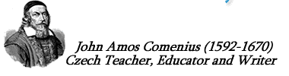
Prague Conference, January 2012
We are all citizens of one world.
Let us have but one end in view,
the welfare of humanity

Slide 5
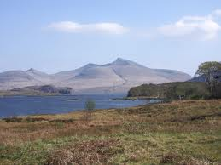
Based on my book...
Overschooled but Undereducated
Knowing What We Now Know...
John Abbott

Slide 6
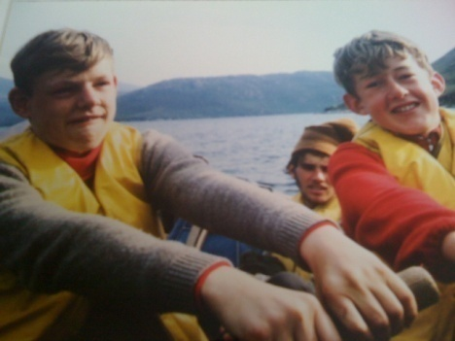
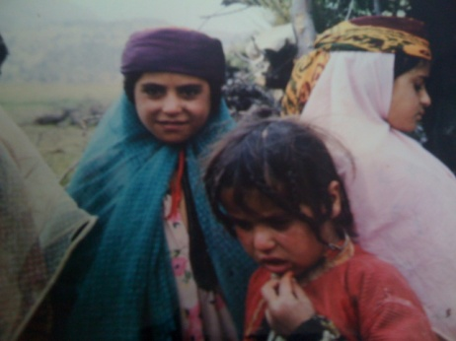
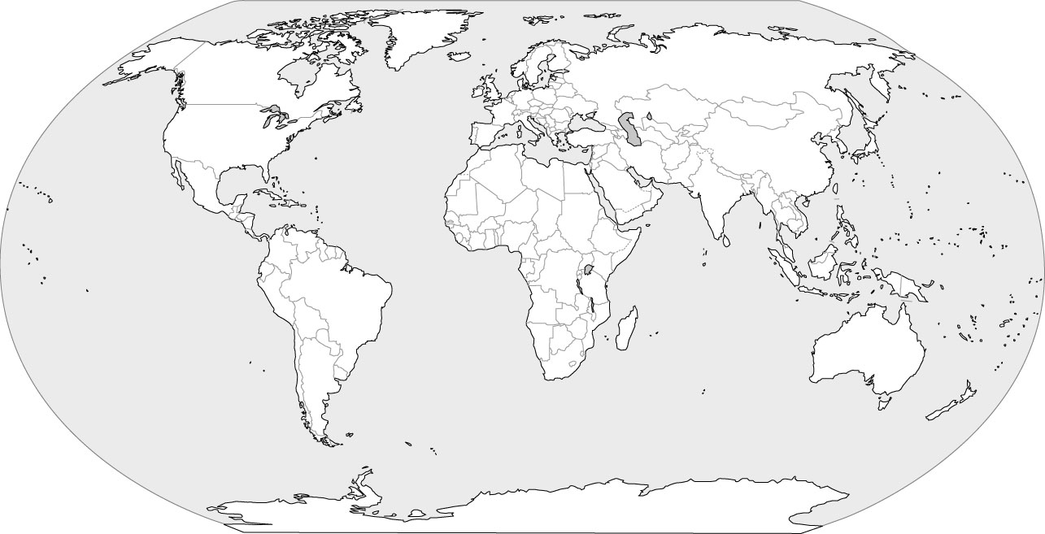
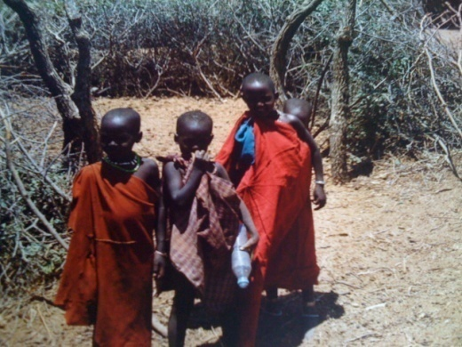
Over 800 lectures…
…in over 40 countries

Slide 7
In The Great Didactic of 1638, Comenius wrote: "Following in the footsteps of nature we find that the process of education will be easy if,
… it begins early, before the mind is corrupted,
… the mind be duly prepared to receive it,
… it proceed from the general to the particular,
… goes from what is easy to what is more difficult
… the pupil is not overburdened by too many subjects
… and if progress be slow in every case,
… the intellect is forced to nothing to which its natural bent does not incline it, in accordance with its age and with the right method,
… everything be taught through the medium of the senses,
… the use of everything taught be continually kept In view.
… everything be taught according to one and the same method.
These, I say, are the principles to be adopted if education is to be easy and pleasant."

Slide 8
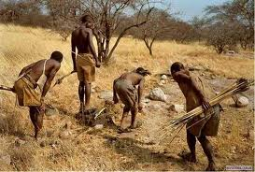
Mindfulness
Can teachers teach mindfulness? Perhaps not, but every teacher can develop their sensitivity to their own presence and that of their students, and by heightening this awareness they can help provide a space that is more conducive to learning.
Kevin Hawkins, Tanzania, 2003
Do we know how to make the best use of children’s amazing brains? That needs more than cleverness – it needs wisdom. And wisdom is a much harder thing to learn and very much harder to teach.

Slide 9
There is a paradox; just because it is self-obvious that humans are born to learn, the reverse – that humans are born to be taught – does not necessarily follow. This has troubled thinkers and philosophers since the beginning of time.

Slide 10
There is a paradox; just because it is self-obvious that humans are born to learn, the reverse – that humans are born to be taught – does not necessarily follow. This has troubled thinkers and philosophers since the beginning of time.
“Those born to be leaders had gold in their blood, those to be administrators silver, while the common man (the vast majority) had only iron”, observed Plato.

Slide 11
There is a paradox; just because it is self-obvious that humans are born to learn, the reverse – that humans are born to be taught – does not necessarily follow. This has troubled thinkers and philosophers since the beginning of time.
“Those born to be leaders had gold in their blood, those to be administrators silver, while the common man (the vast majority) had only iron”, observed Plato.
“Do not confine your children to your own learning, for they were born in another time”, recalled the Ancient Hebrews, while Confucius noted even earlier, “Man’s natures are alike; it is their habits that carry them far apart.” he went on to say, “Tell a child and he will forget; show him and he will remember; but let him do, and he will understand”.

Slide 12
There is a paradox; just because it is self-obvious that humans are born to learn, the reverse – that humans are born to be taught – does not necessarily follow. This has troubled thinkers and philosophers since the beginning of time.
“Those born to be leaders had gold in their blood, those to be administrators silver, while the common man (the vast majority) had only iron”, observed Plato.
“Do not confine your children to your own learning, for they were born in another time”, recalled the Ancient Hebrews, while Confucius noted even earlier, “Man’s natures are alike; it is their habits that carry them far apart.” he went on to say, “Tell a child and he will forget; show him and he will remember; but let him do, and he will understand”.
John Milton (much influenced by Comenius) said, “I call a complete and generous education that which fits a man to perform justly, skilfully, magnanimously, all the offices public and private, of peace and war”.

Slide 13
There is a paradox; just because it is self-obvious that humans are born to learn, the reverse – that humans are born to be taught – does not necessarily follow. This has troubled thinkers and philosophers since the beginning of time.
“Those born to be leaders had gold in their blood, those to be administrators silver, while the common man (the vast majority) had only iron”, observed Plato.
“Do not confine your children to your own learning, for they were born in another time”, recalled the Ancient Hebrews, while Confucius noted even earlier, “Man’s natures are alike; it is their habits that carry them far apart.” he went on to say, “Tell a child and he will forget; show him and he will remember; but let him do, and he will understand”.
John Milton (much influenced by Comenius) said, “I call a complete and generous education that which fits a man to perform justly, skilfully, magnanimously, all the offices public and private, of peace and war”.
While Yolande a “sixteen, going on seventeen” English girl, having completed her GCSEs, wrote last month, “It’s easy to learn how to fit in, it's harder to think outside the box”.

Slide 14
There is a paradox; just because it is self-obvious that humans are born to learn, the reverse – that humans are born to be taught – does not necessarily follow. This has troubled thinkers and philosophers since the beginning of time.
“Those born to be leaders had gold in their blood, those to be administrators silver, while the common man (the vast majority) had only iron”, observed Plato.
“Do not confine your children to your own learning, for they were born in another time”, recalled the Ancient Hebrews, while Confucius noted even earlier, “Man’s natures are alike; it is their habits that carry them far apart.” he went on to say, “Tell a child and he will forget; show him and he will remember; but let him do, and he will understand”.
John Milton (much influenced by Comenius) said, “I call a complete and generous education that which fits a man to perform justly, skilfully, magnanimously, all the offices public and private, of peace and war”.
While Yolande a “sixteen, going on seventeen” English girl, having completed her GCSEs, wrote last month, “It’s easy to learn how to fit in, it's harder to think outside the box”.

Slide 15
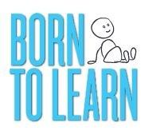
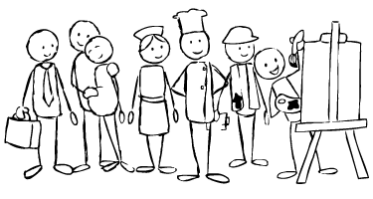
Nb. If when viewing the following slide the animation does not appear, please follow the link below, and then return to this Powerpoint presentation afterwards (the same applies to the other two animations later in the presentation).
Born to Learn
or visit www.vimeo.com/20924263

Slide 16


Slide 17
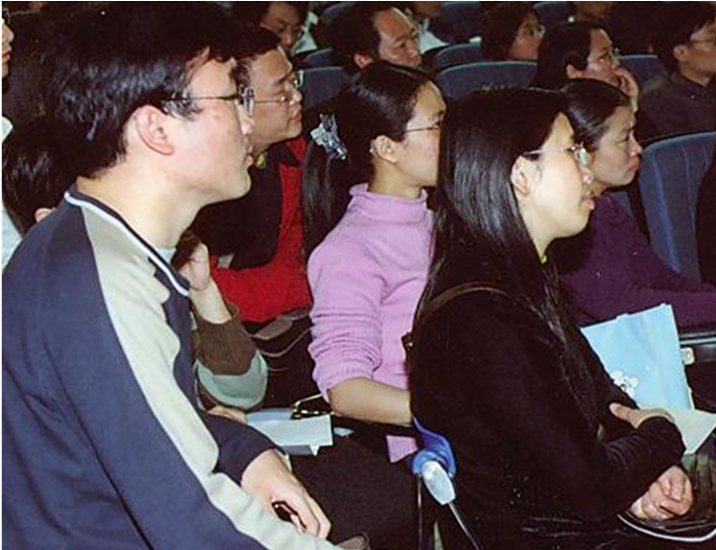
You each have a story to tell...
“The task is not so much to see what no one has yet seen, but to think what nobody yet has thought about that which everybody sees.”
Schopenhauer, 1788-1860

Slide 18
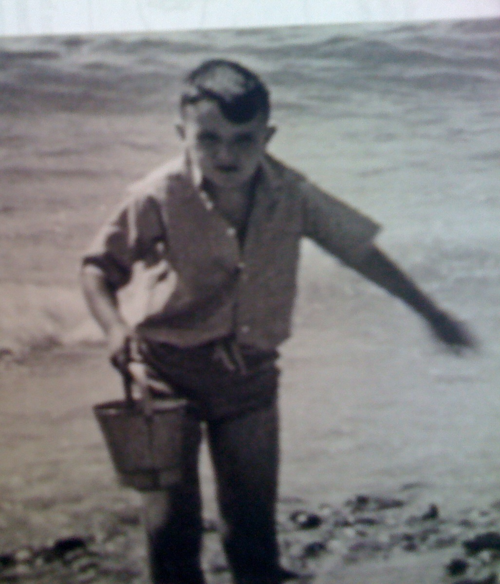
V.E. Day 1945
My Story

Slide 19
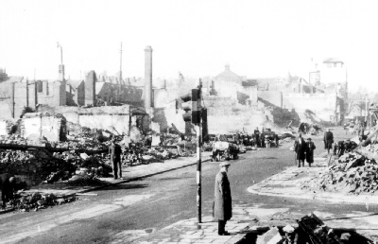
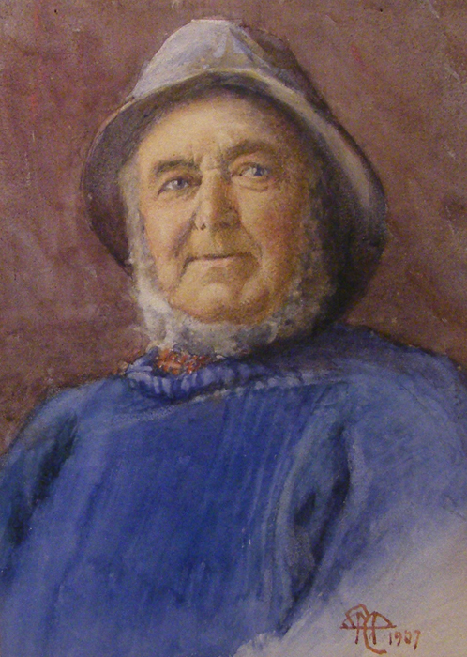

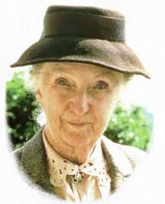

Slide 20

A quality education is like a three-legged stool which can balance, on any surface however rough, providing the legs are the same length – home school and community

Slide 21
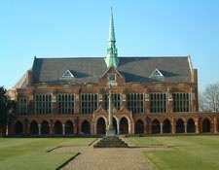

Slide 22
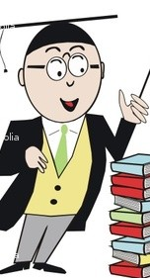
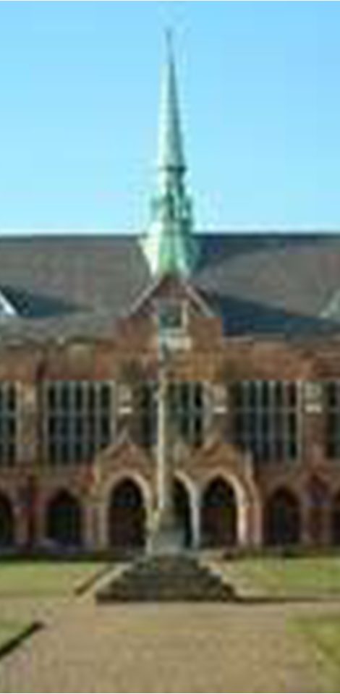
“I call a complete and generous education that which fits a man
to perform justly, skilfully and magnanimously all the offices ,
public and private, of peace and war”
John Milton 1642
“No man is an island entire of itself; every man is a piece of the continent, a part of the main...
And therefore never send to know for whom the bell tolls; it tolls for thee.”
John Donne 1624

Slide 23
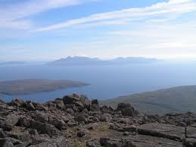

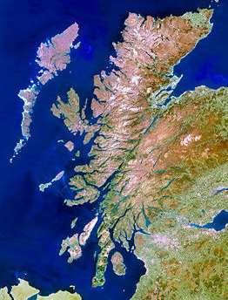

Slide 24
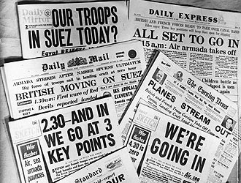
1957
Suez Crisis
Conscription, National Service
Mock Oxbridge Scholarship Paper
Autumn 1957
“The roots of civilisation are twelve inches deep”; discuss

Slide 25
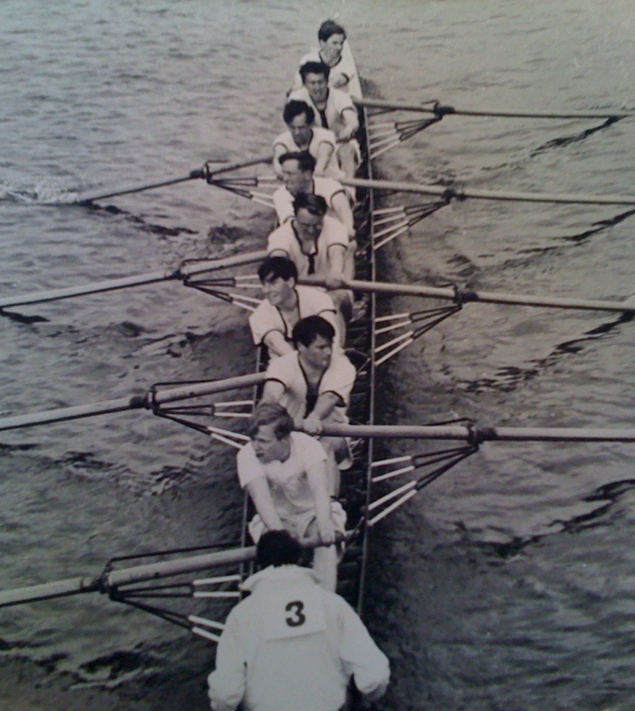

Slide 26
‘In our concentration on academic performance we lose sight of our main business of educating human personality.’
(TES September 1959)
‘All considerations of the curriculum should consider “how best to use subjects for the purpose of education... rather than regarding education as the by-product of the efficient teaching of subjects”.’
(Sir Phillip Morris, 1952)

Slide 27
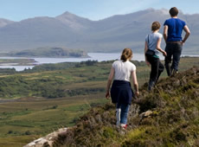

Island of Ulva, 1962

Slide 28
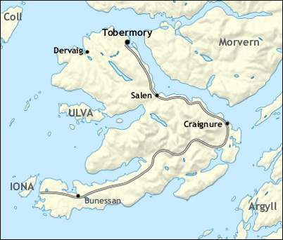
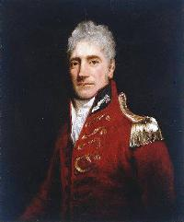
“If you are born on a mere speck of land in the middle of the ocean you quickly discover how things work, and why people do as they do. Learn that lesson well, and you are equipped to become a citizen of the world.”

Slide 29
Citizen of the world?
“The idea that talents are lent for the service of others and not given, and that knowledge should bring humility and a sense of involvement in mankind, has to be the necessary corrective to the arrogance of meritocrats, for without this the School’s record of academic success would be indeed alarming.”
P.G Mason, High Master
Manchester Grammar School, 1965
“Dare to be wise”

Slide 30
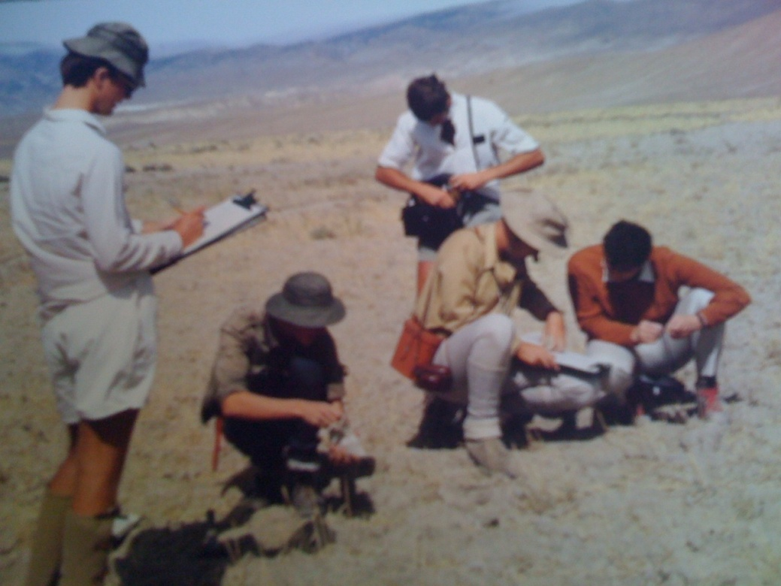
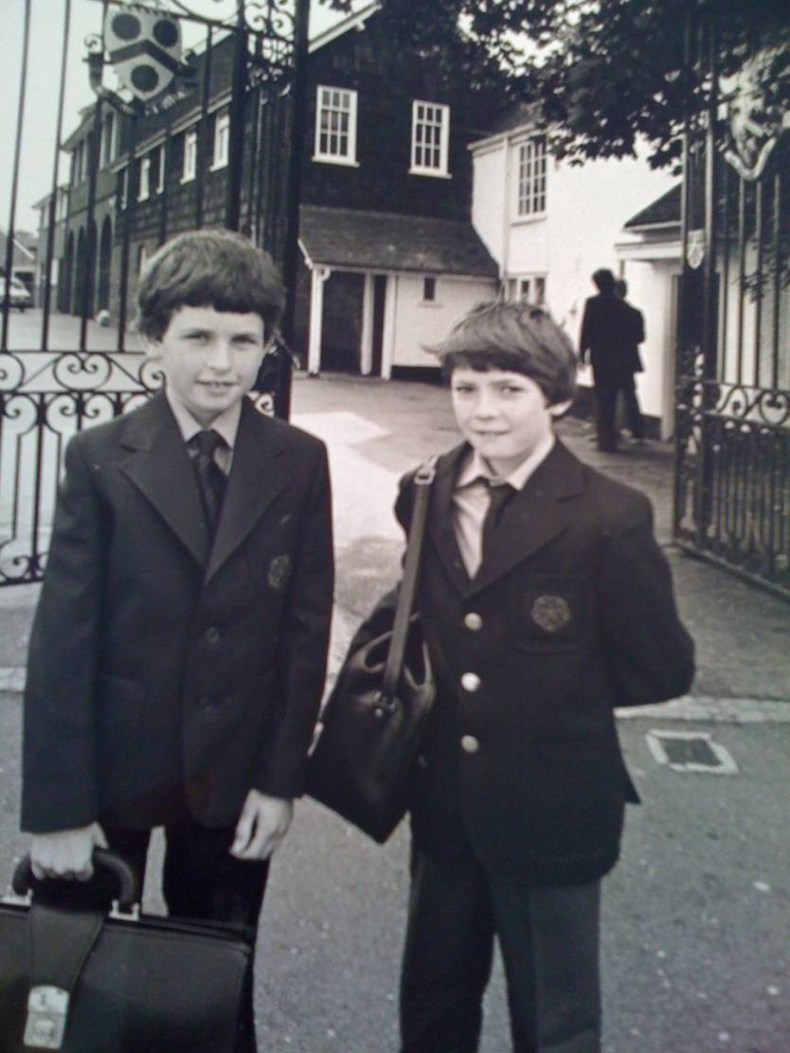
From leader of expeditions to being a Headmaster

Slide 31
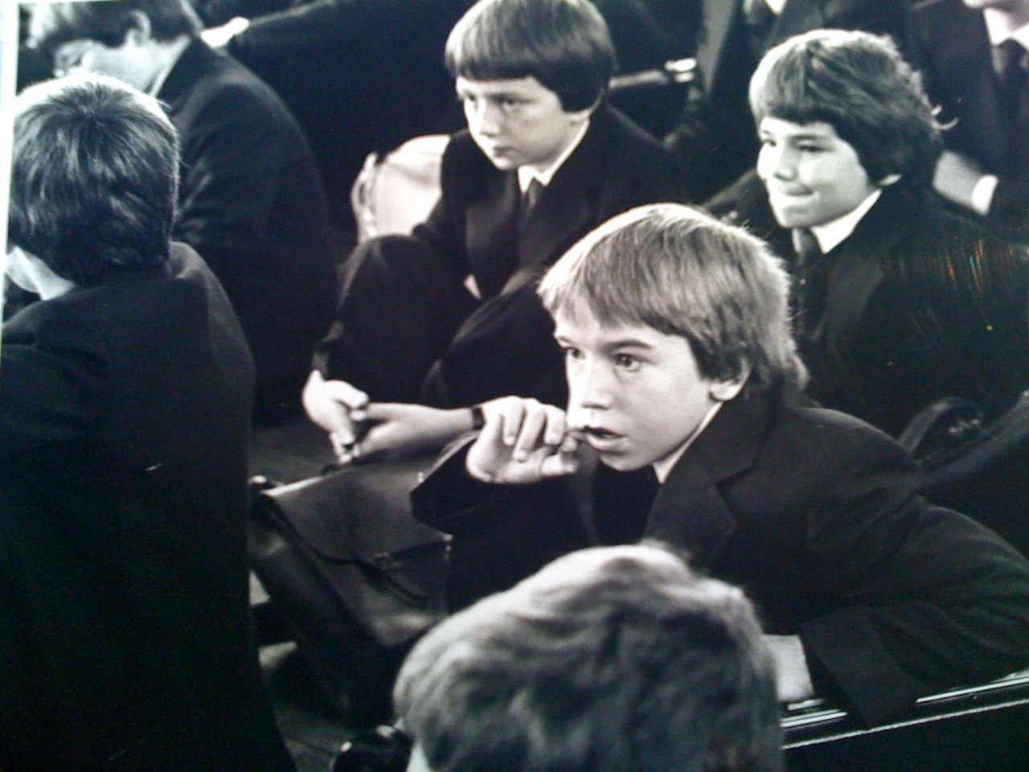
So began my search to understand human learning

Slide 32
Nb. If when viewing the following slide the animation does not appear, please follow the link below, and then return to this Powerpoint presentation afterwards (the same applies to the other animation later in the presentation).
Class Reunion
or visit www.vimeo.com/25962693

Slide 33


Slide 34
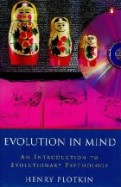
Discovering the origins of human thought and behaviour
Any serious consideration of ‘evolution in brain’ did not enter psychologists’ thinking until the early 1970s (when I studied Education in the mid-sixties there was absolutely no reference to the brain). Not until the invention of PET scans and latterly functional MRI in the late 1970s onwards has the study of cognitive processes been open to visual comprehension.
Suddenly scientists saw in our ‘preferred ways of doing things’ strategies that in all probability have been shaped by the earliest experiences of mankind.

Slide 35
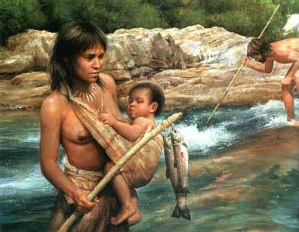
Now, in 2012, we understand...
“Human beings did not fall ready made from the sky. Many of our abilities and susceptibilities are specific adaptations to ancient environmental problems rather than separate manifestations of a general intelligence for all seasons.” (Barrow, 1996)
“The human mind is better equipped to gather information about the world by operating within it than by reading about it, hearing lectures on it, or studying abstract models of it.” (Santa Fee Institute, 1995)

Slide 36
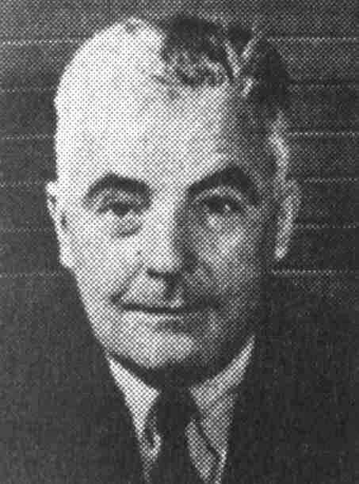
Behaviourism and JB Watson
JB Watson (1878-1958), denied that evolution has any part to play in the understanding of the human brain. It was all to do with the relationship between what a teacher put in, and what a child observed. He believed that learning should become something that schools did to you, and quality instruction as being infinitely more important than encouraging students to think for themselves. He believed that children’s minds were putty to be shaped by well-trained teachers... (the shadow of this thinking has deadened that imagination of millions of children and frustrated a large number of teachers).
Notes:
Not a nice chap!

Slide 37
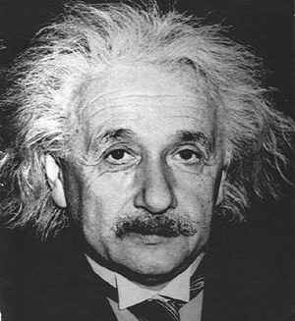
Einstein disagreed profoundly
“It is almost a miracle that modern teaching methods have not yet entirely strangled the holy curiosity of enquiry; for what this delicate little plant needs more than anything, besides stimulation, is freedom.”
Albert Einstein, 1889 - 1955

Slide 38
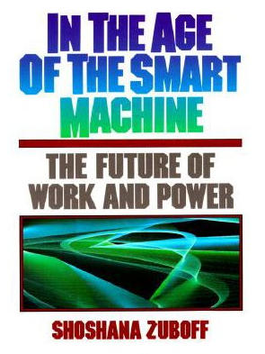

In the 1980s cognitive science, began drawing upon neurobiology began to undermine the claims of the behaviourists
“Learning does not require time out from productive activity; learning is at the heart of productive activity”
Shoshana Zuboff, 1988

Slide 39
A tiny selection of readings....
John Bowlby - Attachment (1969) Howard Gardner - Frames of Mind; the theory of multiple intelligences (1983) Shoshana Zuboff - In the Age of the Smart Machine; the future of work and power (1984) Howard Gardner - The unschooled mind; how children think and how schools should teach (1991) Gerald Edelman - Bright air, brilliant fire (1992) Mitchell Waldrop - Complexity; the emerging science at the edge of order and chaos (1992) Caine and Caine - Making Connections; teaching and the human brain (1991) Christopher Wills - The Runaway Brain (1994) David Perkins - Outsmarting IQ; the emerging science of learnable intelligence (1994) Robert Wright - The Moral Animal; evolutionary psychology and everyday life (1994) John T. Bruer - Schools For Thought; a science for learning in the classroom (1993) Coveney and Highfield - Frontiers of Complexity; the search for order in a chaotic world (1995) Peter Senge - The Fifth Discipline; the art and practice of the learning organization (1990) Stephen Mithen - The Prehistory of the Mind (1996) Arne Wyller - The Planetary Mind (1996) Edward O. Wilson - The Future of Life (2002) Edward O. Wilson - Consilience; the unity of knowledge (1998) Mihaly Csikszentmihalyi - Flow; the psychology of optimal experience (1990) Henry Plotkin - Evolution in Mind (1997) Stephen Pinker - How the Mind Works (1997) Stephen Pinker - The Language Instinct (1996) Patricia Hersch - A Tribe Apart; a journey into the heart of adolescence (1998) Thomas Hine - The Rise and Fall of the American Teenager (1999) Meredith Small - Our Babies, Ourselves; how biology and culture shape the way we parent (1998) Susan Greenfield - Brain Stories (2000) Spencer Wells - The Journey of Man; a genetic odyssey (2002) Fritjof Capra – The Hidden Connections (2002) Matt Ridley – Nature via Nurture: genes, experience and what makes us human (2003) Spencer Wells - Pandora’s Seed; the unforeseen cost of civilisation (2010) Jared Diamond - Guns, Germs and Steel; a short history of everybody for the last 13,000 years (1998) Nicholas Wade - Before the Dawn; recovering the lost history of our ancestors (2006) Diane Ravitch - The Death and Life
of the Great American School System; how testing and choice are undermining education (2010)
Jonathan Sacks - Recreating Society; the home we build together (2007) Raymond Tallis - Aping Mankind; neuromania, Darwinitis and the misrepresentation of humanity (2011)...

Slide 40
The Hidden Connections: a science for sustainable living
Fritjof Capra (2002)
  “Education is the ability to perceive the hidden connections between disparate phenomena,” a statement first made by the Czech philosopher and politician Vaclav Havel, and adopted by Capra as the ultimate explanation for the operation of the brain
Nature via Nurture: genes, experience and what makes us human Matt Ridley (2003)
  Recent findings in the biomedical sciences show that it was totally wrong to see it as a struggle of nature versus nurture, rather it is the development of nature via nurture.
These two create a whole new paradigm for learning

Slide 41
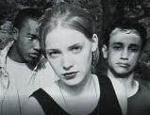

Adolescence
A Tribe Apart ?

Slide 42
Adolescence
From the earliest of times the progression from dependent child to autonomous adult has been an issue of critical importance to all societies.
The adolescent brain, being “crazy by design,” could be a critical evolutionary adaptation that has built up over countless generations, and is essential to our species’ survival. It is adolescence that drives human development by forcing young people in every generation to think beyond their own self-imposed limitations and exceed their parents’ aspirations. These neurological changes in the young brain as it transforms itself means that adolescents have evolved to be apprentice-like learners, not pupils sitting at desks awaiting instruction.
Youngsters who are empowered as adolescents to take charge of their own futures will make better citizens for the future than did so many of their parents and their grandparents who suffered from being overschooled but undereducated in their own generations.

Slide 43
Crazy by Design
We have suspected that there is something going on in the brain of the adolescent, apparently involuntarily, that is forcing apart the child/parent relationship. What neurologists are discovering challenges the conventional belief held until only a year or so ago, that brain formation is largely completed by the age of twelve. Adolescence is a period of profound structural change, in fact “the changes taking place in the brain during adolescence are so profound, they may rival early childhood as a critical period of development”, wrote Barbara Strauch in 2003. “The teenage brain, far from being readymade, undergoes a period of surprisingly complex and crucial development.” The adolescent brain, she suggests, “is crazy by design.”

Slide 44
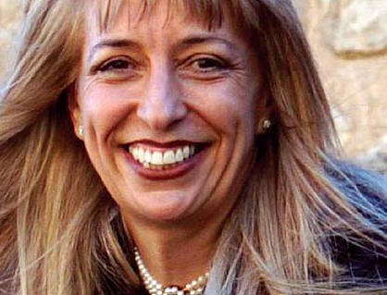
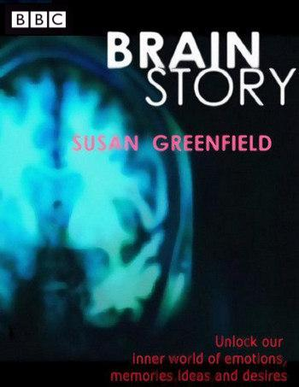
(Professor) Baroness Susan Greenfield
SUSAN GREENFIELD CBE is an eminent neurobiologist who was appointed Director of The Royal Institution in London in 1998. Since 1996 she has been Professor of Pharmacology at the University of Oxford. Her research concentrates on understanding brain functions and disorders, such as Parkinson's and Alzheimer's diseases, as well as the physical basis of consciousness. She has also spoken out about the impact of social networking sites and the amount of time children and young people spend in front of computer screens:
“By the middle of this century, our minds might have become infantilised - characterised by short attention spans, an inability to empathise and a shaky sense of identity,”

Slide 45
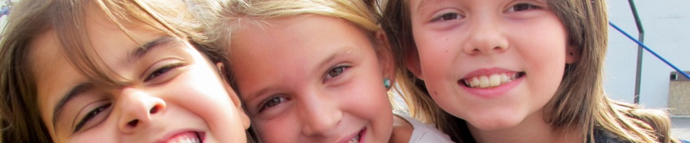
The “New” Adolescent
Between childhood and adolescence there is a stage of development that Sigmund Freud called “the latency period”, when boys and girls turned their backs on each other and formed special attachments with same-sex peers. It was a time when they gathered physical and psychological strength to explore the world…. marshalling their forces to be able to go into puberty.
Dr Michael Carr-Gregg, “The Age”, Australia, 30th April 2004

Slide 46

The “New” Adolescent continued...
What we are seeing is a short-circuiting of the latency period, when youngsters used to develop a sense of who they were, and how they fitted into the world. Today some young people merely dip their toes into the latency period before a combination of peer pressure, an unrelenting marketing machine and their own physiology lures them into the kaleidoscope of adolescence… Combined with time-poor parents, lack of ritual and tradition, spiritual anorexia, mixed media massages, higher material expectations, academic requirements, this makes the adolescents (of 2012) arguably the most vulnerable generation Australia has ever seen.

Slide 47
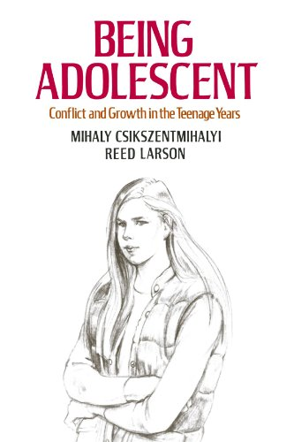
Synaptogenesis
We know that the human brain is essentially plastic, but it constantly reshapes itself in response to environmental challenges, but that it does this within the blueprint of the species’ inherited experience. There are three phases during the normal life cycle when the brain goes through extraordinary periods of internal reorganization - a kind of mental housekeeping. Experience during each of these phases becomes critical to how the individual brain is reconfigured to deal with the next stage of life.
1993

Slide 48
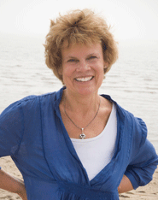
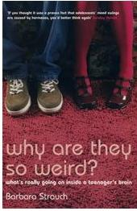
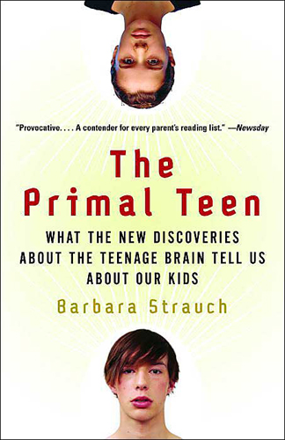
Crazy by Design
We have long suspected that there is something going on in the brain of the adolescent, apparently involuntarily, that is forcing apart the child/parent relationship. Adolescence is a period of profound structural change, in fact “the changes taking place in the brain during adolescence are so profound, they may rival early childhood as a critical period of development”, wrote Barbara Strauch in 2003. “The teenage brain, far from being readymade, undergoes a period of surprisingly complex and crucial development.
The adolescent brain is crazy by design.”

Slide 49
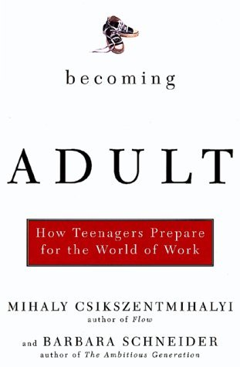
Becoming Adult
From the earliest of times the progression from dependent child to autonomous adult has been an issue of critical importance to all societies.
The adolescent brain, being “crazy by design,” could be a critical evolutionary adaptation that has built up over countless generations, and is essential to our species’ survival. It is adolescence that drives human development by forcing young people in every generation to think beyond their own self-imposed limitations and exceed their parents’ aspirations. These neurological changes in the young brain as it transforms itself means that adolescents have evolved to be apprentice-like learners, not pupils sitting at desks awaiting instruction.
2002

Slide 50
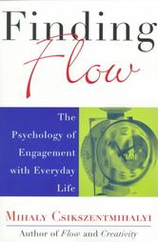
Flow
Neuroscientists, together with psychologists and evolutionary scientists are starting to “show that youngsters who are empowered as adolescents to take charge of their own futures will make better citizens for the future than did so many of their parents and their grandparents who suffered from being overschooled but undereducated in their own generations.”
“Students who get the most out of school, and have the highest future expectations, are those who find school more play-like than work-like.
1997
“Clear vocational goals and good work experiences do not guarantee a smooth transition to adult work. Engaging activities – with intense involvement regardless of content – are essential for building the optimism and resilience crucial to satisfying work lives.”

Slide 51

Don’t Fence Me In – Cole Porter, 1934
Oh, give me land, lots of land under starry skies above,
Don't fence me in.
Let me ride through the wide open country that I love,
Don't fence me in.
Let me be by myself in the evenin' breeze,
And listen to the murmur of the cottonwood trees,
Send me off forever but I ask you please,
Don't fence me in.

Slide 52
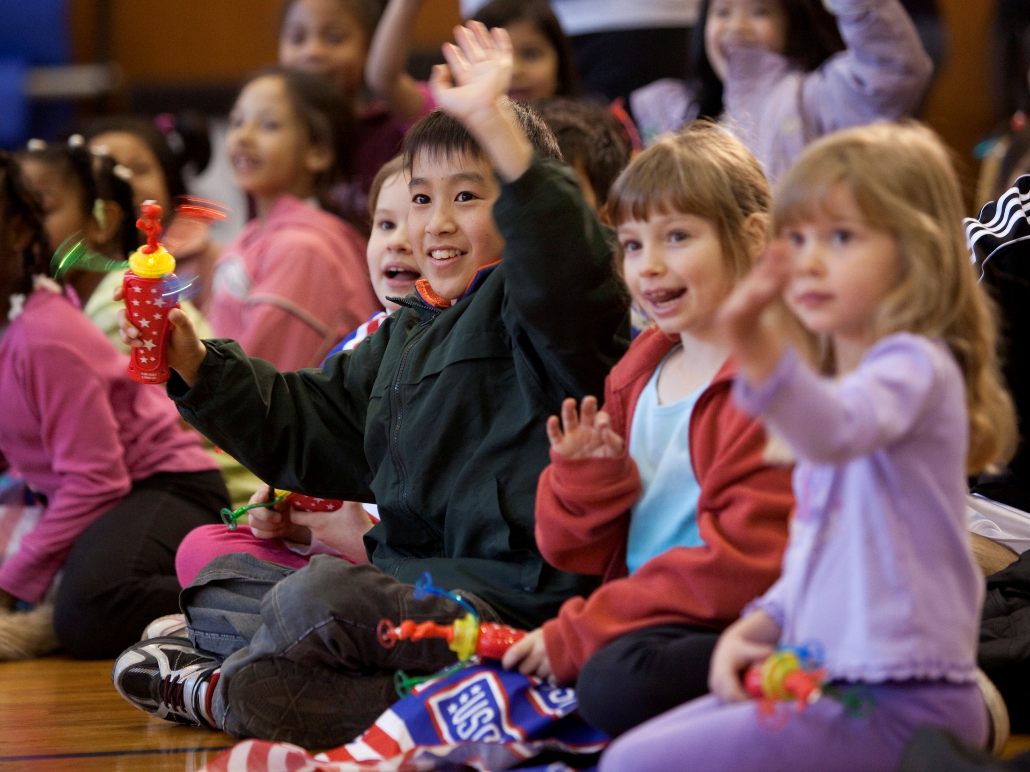
So What Now?
Formal schooling, therefore, has to start a dynamic process through which students are progressively weaned from their dependence on teachers and institutions, and given the confidence to manage their own learning, collaborating with colleagues as appropriate, and using a range of resources and learning situations.

Slide 53
Nb. If when viewing the following slide the animation does not appear, please follow the link below, and then return to this Powerpoint presentation afterwards.
Faustian Bargain (trailer)
or visit www.vimeo.com/29948790

Slide 54
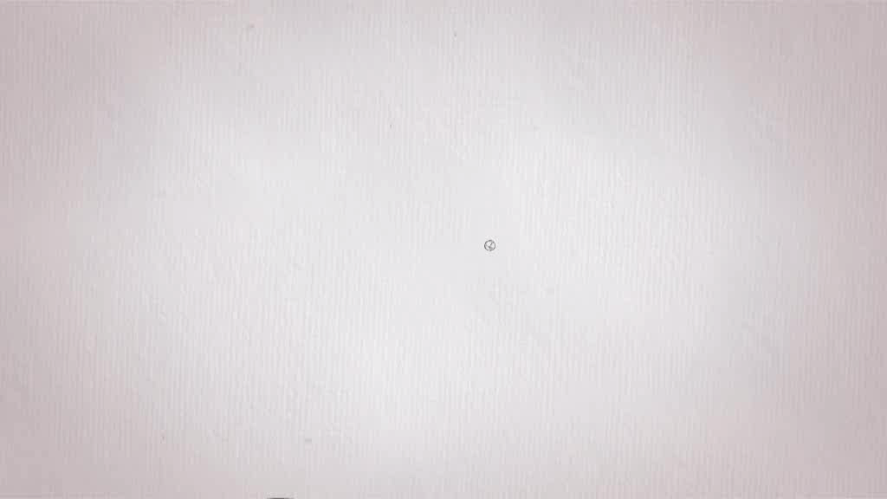

Slide 55
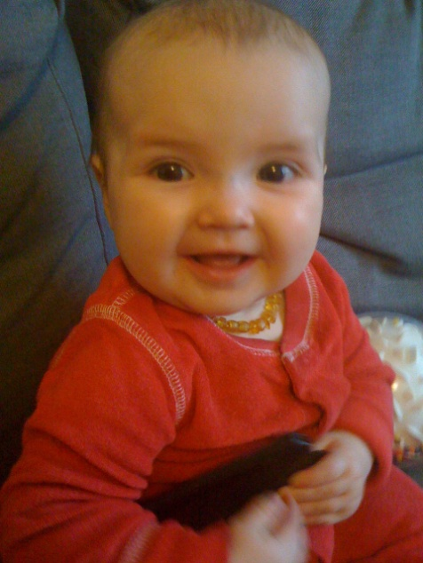
Time is going by
"The biggest crisis we are facing is a Crisis of Meaning. The tremendous social changes of the last 100 years have stripped modern society of that which gives us meaning be it in our roots to our ancestors, religions, spirituality, our relationship to nature...... Within this Crisis of Meaning our young people are facing a MORAL crisis - a crisis of values. Without these anchors young people no longer understand the value of perseverance, learning for learning's sake etc.. Instead our daily lives are filled with a pursuit of money and temporary ecstasy. Both of these goals are
unfulfillable and result in a misguided frenzy in the
pursuit of the next thrill, or in depression.
E-mail from Dr Rolando Jubis
Psychologist and Counselor
Jakarta International School, 11/11/00

Slide 56
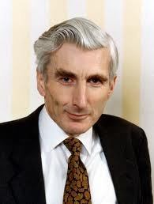

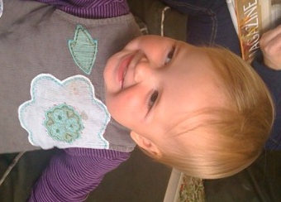
Asked on 1st January 2000 what chance he gave the world of surviving the next thousand years, Sir Martin Rees, the Astronomer Royal and later President of the Royal Society said; “I’m not sure about the next millennium but I think I give us a 50/50 chance of surviving the next hundred years. I fear that the speed of man’s technological discoveries is outpacing our wisdom and ability to control what we have discovered…”
When our first granddaughter was born a year ago, our doctor said with great pleasure “she has a 25 % chance of living to the age of 100”.

Slide 57


For Aurelie and Jacob to do that we have to educate the next generation to bring technological knowledge and wisdom together into a seamless piece.
10th January 2012

Slide 58

Laura Dekker
An immediate thought to ponder: last week the 16 year-old Dutch girl Laura Dekker succeeded in sailing round the world herself, despite the best efforts of the Dutch authorities to insist that she was not old enough to take responsibility for such an action. What does her success suggest to parents and everyone involved in education as to how much freedom ‘children’ should have? How many Laura Dekkers may be sitting frustrated in our classrooms ? Furthermore what does Laura do now she has done this?

Slide 59
Just what are we all about?
I would like to set you two questions – not to be answered today – but perhaps to be sent to me alter by email, not in any sense for correction, far from it, but to get all of us thinking together about what needs to happen
My first question is about purpose:
“Are you preparing your pupils to be pilgrims (as in John Bunyan’s meaning in Pilgrim's Progress), or customers?”
My second question is about process:
“What kind of education for what kind of world? Are our children battery-hens or free-range chickens?”

Slide 60

Upon this gifted age, in its dark hour,
Rains from the sky a meteoric shower
Of facts....They lie unquestioned, uncombined.
Wisdom enough to leech us of our ill
Is daily spun, but there exists no loom
To weave it into fabric.
Edna St. Vincent Millay "Huntsman, What Quarry"

Slide 61

“There is a tide in the affairs of men which, taken at the flood, leads on to fortune...”

Slide 62

“...But omitted, and the voyage of their life is bound in shallows and miseries...”

Slide 63

“... On such a full sea are we now afloat, and we must take the current when it serves -- or lose the ventures before us.”
William Shakespeare, Julius Caesar, Act 4, Scene 3

Slide 64
So what is it we have to do?
“Begin to move from institutional solutions to environments that foster individual empowerment.”
The 21st Century Learning Initiative

Slide 65
Postscript 30.01.2012
1/3
Returning to my computer the morning after the Prague conference I received this email from a student to the animations, giving her permission to publish this response. While you are pondering the issues raised by Laura Dekker you will have to think very carefully as you let this girl’s ideas sink in...
“The harder I study, the worse I do. Math is not my thing, I don't fit that shoe. I feel so incapable, so possibly mistake-able. Like I'm disgrace-able and not chase-able, when I can't fill in answers that aren’t erase-able... No tutoring session can set my confusion free, I should go back to the age of three. Its embarrassing knowing the hot girl in class can do it, and I'm like Shit, I'm not even half way through it.. Then I think of all the ways at least I know I don't know. If Socrates were alive, he would be happy with my show. Like water our conversation would flow. Discourse so blue it would glow. That's right, blue is hotter than red. Despite the mass disillusion shoved in your head. Energy doesn't vibrate at the same frequency, that's just one difference between all of them and me. Some times I wonder if its the world or if its me. Maybe ill have to wait and die, to see... (continued on next slide)

Slide 66
2/3
... When your eyes are closed you can see the best. This is the metaphysics question put to the test... Education is a multiple choice test, where you color in lettered squares. But life is an essay question- explain what is wrong with my curves.. Why am I so varied from the rest? Why do these questions spring my within my chest? They bring me no rest, which I wouldn't want, I confess... But does anyone need a curious human for hire? Its lonely being the black sheep outlier. I'm bombarded with sights of bums while they only notice billboards, I have flash cards flying around my car, on a unique path following my own star, as I speed to school from work on the ten.. And they find themselves logging onto Facebook again. Oh the irony in life, people who earn peace still endure strife. And most girls from my ap class, have accumulated thick mass, from guys they've dated, while both faded, a baby is now their destiny, and I'm the one signing up for astronomy.. I'm the one with transferring on my mind, the girl in the front whose always behind.. sometimes I wish I was like those ignorant girls floating in bliss..
(continued on next slide)

Slide 67
3/3
... Drinking to get belligerent and getting in the car with highest tint, sucking my portion with plan b of abortion, and washing it down with a mint if you can get a hint...Like that blonde girl from get a clue, its too bad I can't fit those shoes.. But its not too bad, no it is all good. And I won't stay sad, even if I should. I rather be frustrated me than confused you. I choose the minority, among the seldom few.. With the gift of thought, comes the responsibility of what to do. Better to shed tears but not spread legs, better to my mind my morals than have to do what the man says. Miss independent here I guess. I chew more and eat less. A scantron can't portray my knowledge. Learned that one way before college. I'm not a robot to fill out these bubbles, like a jock I'm taking these fumbles. Fellow students don't think I'm that bright, I ask questions to bring brainwashing darkness to light, but I ask too many questions, they want me out of their sight.”

Slide 68

For further information:
Web www.born-to-learn.org
www.21learn.org
Email mail@21learn.org

Slide 69
Reserves
The following slides form part of reserve collection that might have been used should subsequent questions have led in this direction

Slide 70
"I maintain that the human mystery is incredibly demeaned by scientific reductionism, with its claim in promissory materialism to account eventually for all of the spiritual world in terms of patterns of neural activity. This belief must be classed as a superstition... we are spiritual beings with souls in a spiritual world, as well as material beings with bodies and brains existing in a material world."
Sir John Eccles, 1989
Neurologist, Nobel Prize Winner, Cambridge

Slide 71
Spirituality
"Mystical, symbolic and religious thinking all those ways of thinking that the rationalist would condemn as " irrational" - seem to characterize human thinking everywhere and at every time. It is as if there was some adaptive advantage to such modes of thinking that offers benefits that rationality can not provide. Perhaps the advantages that irrational, speculative, and religious beliefs offer through their ability to spur us to actions with positive consequences are significant enough to account for our propensity towards their adoption. Extraterrestrial robots who are completely rational might evolve very slowly indeed."
John D. Barrow
The Artful Universe, 1996

Slide 72
What is Man?
When I consider your heavens,
The work of your fingers,
The moon and the stars,
Which you have set in place.
What is man that you are mindful of him,
The son of man that you care for him?
Yet you have made him little lower
than the angels
And crowned him with glory and honour.
Psalm 8: 3-5

Slide 73
The Spiritual Issue; Neil Postman, 1997
"We do not need to invent a story for our times out of nothing. Humans never do. Since consciousness began we have been weaving our experience of ourselves and of our material world into accounts of it; and every generation has passed its ways of accounting on.... The great revolutions and revelations of the human past, and I include the Christian revelation, have all been great retellings, new ways of narrating ancient truths to encompass a larger world.
My two favourite quotes: Galileo in the early 17th century said,
"The intention of the Holy Spirit is to teach how one goes to heaven, not how heaven goes.”
Three hundred and seventy five years later, Pope John Paul II said,
"Science can purify religion from error and superstition.
Religion can purify science from idolatry and false absolutes. "

Slide 74
"The future sanity of the world depends on the coming together of two great disciplines that haven't spoken together for more than a hundred years - Biology and Theology".
State of the World Forum, San Francisco, 2001

Slide 75
"This is what we are about. We plant seeds that one day will grow. We water seeds already planted, knowing that they hold future promise. We lay foundations that will need further development. We provide yeast that produces effects far beyond our capabilities.
"We cannot do everything, and there is a sense of liberation in realising that. This enables us to do something, and enables us to do it very well It may be incomplete, but it is a beginning, a step along the way, an opportunity for the Lord's grace to enter and do the rest. We may never see the end result, but that is the difference between the master builder, and
the worker.
"We are workers, not master builders, ministers, not Messiahs. We are prophets of a future not our own".
Archbishop Oscar Romero, 1980

Slide 76
“The new middle-class world in which many American adolescents grow up is one that combines harshness and heedlessness in equal measure, a world which makes it very hard to grow up. It makes it all too difficult to achieve a strong and abiding sense of worth and all too easy to feel like a failure and a loser. It makes it all too easy to feel like an outsider, all too difficult to feel appreciated or respected for being who you are. It is a world in which it is treacherously easy for adolescents to trip up and break the rules but in which no one can be bothered to help them avoid tripping in the first place. Adolescence is rarely an easy time. But it need not be as hard as it often is in America.
The Road to Whatever, Elliott Currie, 2004

Slide 77
Lost by Anne-Marie, aged 18, Killarney, May 2004
1/3
As I sit there the wind goes by
Not moving anything.
The clouds slowly move across the sky
With a feeling of departure.
I’m lost, I’m lost in this dark deep place.
I’m screaming from inside for it to go away.
It’s too late.
I stand with a sharp object in my hand.
I feel I’ve been crying for years.
My face reflects this, swollen and red.
As I stand there motionless, I think: why stay?

Slide 78
2/3
I’ve hurt so many – even my own flesh and blood.
The sky keeps moving
I stay locked within the dark circle, and life moves by.
I look at the object that lies in my hand.
I slowly move it to my heart and press hard.
I feel a sharp stinging pain but I continue.
I continue to feel the sharp object penetrate my skin.
The suddenly I stop. I think: I can’t, I can’t do this.
I drop to my knees, open my mouth to scream
But nothing comes out.

Slide 79
3/3
I stay there, tears rolling down my cheeks, and a clean
knife lies by my side.
I feel ashamed, yet disappointed.
I wonder: why does life have to be so hard?
Why do people have to feel so much pain?
It’s so unfair, it’s so draining and confusing.
I’m tired of fighting; I’m tired of fighting with myself
I just want it to stop.

Slide 80
F
“I call a complete and generous education that which equips a man to perform justly, skilfully and magnanimously all the offices public and private of peace and war”
John Milton
1644

Slide 81
F
Dear Teacher,
I am a survivor of a concentration camp. My eyes saw what no man should witness:
  Gas chambers built by learned engineers;
  Children poisoned by educated physicians;
  Infants killed by trained nurses;
  Women and babies shot and burned by high school and college graduates.
So, I am suspicious of education. My request is this: help your students become human. Your efforts must never produce learned monsters, skilled psychopaths, educated Eichmanns. Reading, writing, arithmetic are important only if they serve to make our children more human.
Reproduced from TACADE, 1993

Slide 82
F
Upside Down and Inside Out
A possible description of the assumption we have inherited about systems of learning, namely, that older students should be taken more seriously than younger students and that the only learning that really matters is that which is formal. This presentation will call for these assumptions to be reversed in the light of modern understanding about how humans learn.

Slide 83
Guiding Questions
How do we create a sense of urgency to move theory around human learning to practice in our classrooms? What overarching structures need to change to facilitate this shift?
Paint us a picture of what a classroom that is reflecting this shift would look like. Sound like. For teachers and for students. How do we create such classrooms within our existing structures?
What are three things we should consider as we move toward having full-day kindergarten classes in our schools next year?
“Is education about content or process?” Could you expand on this idea?
How do we nurture the natural stages of development of early learners and adolescents? How can we embrace their appetite for adventure and ensure that we are not inadvertently repressing it at any stage?

Slide 84
Guiding Questions
21st Century Learning became a common buzzword over the last year. How do you define 21st Century Learning? How does technology fit into your definition?
Could you expand on your ideas around the following:
“In a phrase, it is the collapse of civil society ... [that requires us to] start a dynamic process through which young people are progressively weaned from their dependence on teachers and institutions...”

Slide 85
‘It’s your world to shape, not just to take’
John Abbott
President, The 21st Century Learning Initiative

Slide 86
Breakout Groups
Preparing young people to think about education in a very different fashion; developing the ability to think, communicate, collaborate and make decisions
Preparing ourselves to devise strategies that go with ‘the grain of the brain’; education as the precursor to a functional democracy
Building communities that accept responsibility to uses all their resources to support the development of young people; cognitive apprenticeship, and Subsidiarity
Helping society in general to understand the need to reverse an upside down and inside-out system of schooling so as to prepare young people more effectively to stand o their own two feet
‘Ill fares the land, where wealth accumulates and men decay’ (Oliver Goldsmith); helping the next generations to live in a post-capitalist society.

Slide 87
Think communicate collaborate make decisions
Both social capital and democracy are slippery concepts. Democracy is particularly fragile and is forever dependent on an educated public being able to hold politicians to account for the small print of their highly-vaunted political promises.
Cognitive Apprenticeship. The development of our exquisite practical and theoretical skills goes right back into the mists of time when our ancestors learnt interactively as they struggled together to achieve common tasks. Through such intellectual processes a pre-disposition for cognitive apprenticeship developed in the human brain.
Learning together within the security of the family, before sharing and testing more complex issues within a larger community is what is most natural to the brain – a progression from emotional to inspirational and on to intellectual development. Cognitive apprenticeship is about making thinking visible. (Modelling, Scaffolding, Fading)

Slide 88
Subsidiarity: it is wrong for a superior body t hold to itself the right to make decisions that an inferior is already able to make for itself. Subsidiarity is not the same as delegation. If, as an adult or an inquisitive young person, you equip yourself to be able to do something, and then you are constantly overruled or micro-managed, you fast lose your motivation as control is taken away from you. Subsidiarity is what adolescents demand if they are eventually to become the functioning adults; deny the this opportunity and they fester.
“The day is not far off when the economic problem will take the back
seat where it belongs, and the arena of the heart and the head will be occupied or reoccupied by our real problems — the problems of life
and of human relations, of creation and behaviour and religion.”
John Maynard Keynes
(1883 – 1946)

